Slide 1




SMART INDIA HACKATHON 2026
Title Page
  Problem Statement ID – SIH26027
  Problem Statement Title - Al-Powered Automatic Block Planning to Maximize Asset Availability for Train Operations on Indian Railways
  Theme- Transportation and Logistics
  PS Category - Software
  Team ID - SIH26027
  Team Name - LastCommit

Slide 2
LastCommit
AI-Powered Automatic Block Planning System for Indian Railways
PROBLEM : How can Indian Railways intelligently coordinate maintenance blocks to avoid train conflicts, repeated track closures, delays, and asset downtime?
SOLUTION in short : An intelligent railway scheduling system that analyzes train schedules, asset health, and maintenance requests to detect conflicts, find optimal maintenance windows, and coordinate work into unified Corridor Mega-Blocks.
Explaination of the Proposed Solution
How it addresses the problem
Innovation and uniqueness of the solution
Algorithmic decision-support vs
manual paper planning
  Automated Planning Platform: Integrates maintenance requests and reduces manual coordination and trail-and-error planning.
  Multi-Source Data Ingestion: Integrates live Train Timetables (COA), Track Defects (TMS), Signalling (SMMS), and Overhead Equipment (TDMS).
  AI-Based Maintenance Prioritization: Prioritizes maintenance tasks based on criticality, urgency and impact on asset availability.
  Multi-Horizon Rostering: Generates high-level Monthly Maintenance Calendars and refined Weekly Block Rosters with dynamic real-time re-planning.
  Traffic-Aware Data: Integrates COA block availability, train timetable and goods-train forecast.
Train-aware planning &
departmental coordination
  Safety & Operational Constraints: Ensures recommended blocks follows required operational and safety.
  Breaks Departmental Silos: Bridges Civil (P-Way), Signal & Telecom (S&T), and Electrical (TRD) to eliminate repeated closures on identical corridors.
  Multi-Tier Priority Scorer: Weights train classes (Vande Bharat = 5.0, Express = 2.5, Freight = 1.0) to strictly penalize delays on premium passenger services.
  Dispatcher Cockpit Visibility: Delivers live interactive Gantt charts with 1-click AI recommendation locks and automated collision alerts for Section Controllers.
Breakthrough technical differentiators
• "Shadow Blocking" & Mega-Blocks: When Track A closes for rail tamping, system automatically scans degraded S&T / OHE assets (<70% health) on Track A and bundles repairs into one joint closure.
• Sliding-Window AI Optimizer: Heuristic 24-hr scan in 30-minute steps computing Disruption Cost to recommend Top 3 conflict-free alternative slots.
• Explainable AI (XAI): Gives plain-English operational reasoning for each recommendation ("Zero train conflicts, bundles 3 assets, saves 270 min").
• Northern Railway Validation: Tested on Delhi–Ghaziabad Quadruple Trunk Corridor (11 clashes → 0; 8.5h downtime restored; 270 min saved)
Track + OHE + S&T → Compatible works → Common Coordinated Block.
@SIH Idea submission- Template
2

Slide 3










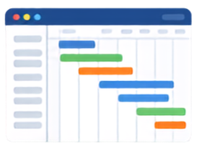





















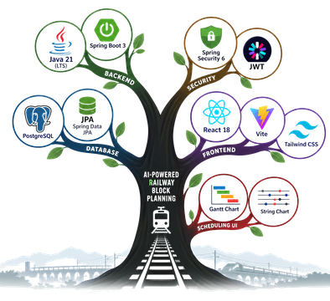


















LastCommit
TECHNICAL APPROACH & SYSTEM ARCHITECTURE
DATA FLOW
SYSTEM ARCHITECTURE
User Input
Investigation(CAO/TMS)
Web Application
Dispatcher cockpit Dashboard
Spring Boot Backend
AI / Optimization Engine
Output & Verification
(React 18 + Vite SPA)
(Multi-track Gantt)
(Java 21 LTS)
(Controller 1-click lock)
Backend APIs
Core Modules
2D conflict engine 15m headway buffer
Constant Checking
User/Operator
Core Module
Sliding-window search
REPORT
Conflict Detection
CPU Module
Shadow mega-blocks
AI Optimiser
Optimized Plan
Verification
PostgreSQL Database
Offline Verification & Signature Workflow
Final Verdict Report (PDF)
FRONTEND
BACKEND
DATABASE
ALGORITHMS
AI / DECISION ENGINE
DEPLOYMENT
TOOLS & PDF
React 18
Java 21 (LTS)
2DCollision Detection
Disruption Cost Model
docker
PDF Export
Vite
Spring Boot 3
15m Buffer
Shadow Blocks
Vercel
Offline Signature
Tailwind CSS
Spring Data JPA
PostgreSQL
Sliding Window Search
XAI (Explainable AI)
Cloud DB
Swagger
@SIH Idea submission- Template
3

Slide 4
LastCommit
FEASIBILITY, VIABILITY & RISK MITIGATION
💻 Technical Feasibility (100% Proven)
Validated working full-stack prototype
• Enterprise Architecture: Built on enterprise Java 21, Spring Boot, and PostgreSQL; highly modular, resilient, and horizontally scalable.
• Sub-Second Latency: Conflict check takes <50ms; 24-hr schedule optimization finishes in <200ms, ensuring instantaneous UI feedback.
• Authentic Dataset Proof: Pre-seeded and verified on Northern Railway NDLS–GZB quadrupled trunk dataset (16 tracks, 16 assets, 12 trains).
🚉 Operational Feasibility (Zero Friction)
Seamless integration into IR workflows
• Preserves Hierarchy: Seamlessly overlays on existing BDMS and COA procedures without altering command structures or retraining staff.
• Human-in-the-Loop: Controllers retain full final override authority; AI serves as an intelligent advisory copilot, not a black-box replacement.
• Intuitive Cockpit: Replaces dense paper registers with a modern visual Gantt timeline showing real-time track occupation.
💰 Financial & Resource Viability
High ROI & minimal infrastructure cost
• Zero Hardware Mandate: Pure software intelligence; runs on commodity cloud (NIC/AWS) or IR data centers with zero bespoke line-side track sensors.
• Rapid Financial ROI: Slashes passenger delay penalties, eliminates diesel train idling wastage, and avoids catastrophic emergency track repairs.
• Asset Longevity: Predictive shadow-blocking prevents neglected point machines and OHE wires from reaching catastrophic failure.
Operational Challenge / Risk | Potential Impact on Operations | Technical Mitigation Strategy | Status & Feasibility
Departmental Data Silos (TMS, SMMS, TDMS in separate legacy systems) | Incompatible formats, delayed approvals, duplicate line possessions | Unified Ingestion Adapter Layer: Standardized REST/JSON schemas, data validation, and automated staging ETL pipelines | Prototype Built & Verified
Dynamic Operational Disruptions (Unscheduled freight, sudden delays, rail fractures) | Pre-planned maintenance block clashes with delayed passenger trains | Event-Driven Dynamic Re-Planning Engine: Automated rescheduling triggered by live COA delay feeds in <200ms | Algorithm Verified in Code
Controller Adoption & Skepticism (Staff resistance to automated algorithms) | Controllers ignore recommendations and rely on manual phone calls | Explainable AI (XAI) Cockpit: Displays transparent operational rationale ('Zero conflicts, bundles 3 assets, saves 270 min') | UI Implemented & Active
@SIH Idea submission- Template
4

Slide 5
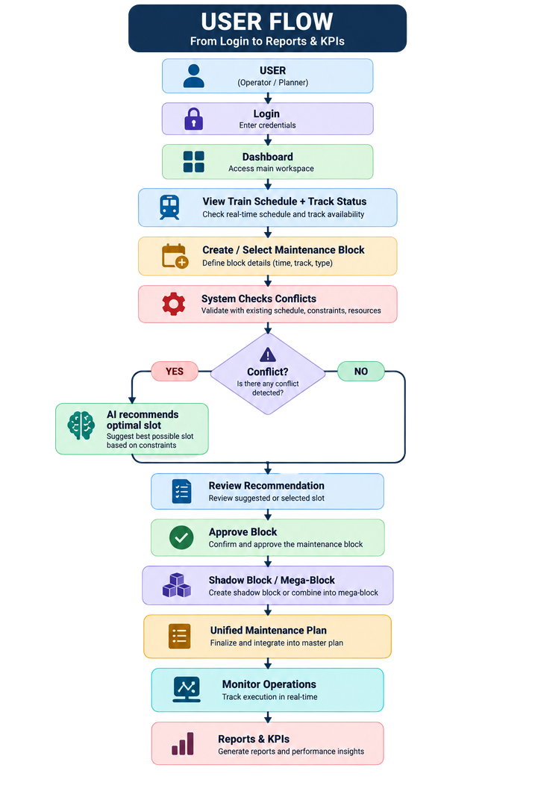



LastCommit
IMPACT, QUANTIFIED BENEFITS & BENCHMARKS
ENVIRONMENTAL IMPACT
SOCIAL IMPACT
ECONOMIC IMPACT
IMPACT
Reduce Train Idling - Better block coordination minimizes avoidable train detention during maintenance.
Reduce Machine Idle Time - Blocks are planned around maintenance-machine availability, reducing unnecessary waiting and running.
Reduce Unnecessary Machine Movement - Work is planned considering machine location and sequence, avoiding avoidable deployment and movement.
Improve Energy Efficiency - Fewer conflicting blocks and stop–wait cycles reduce wasted traction and operational energy.
BENEFIT
→ Lower fuel & energy consumption, reduced operational waste, and a smaller environmental footprint.
IMPACT
Fewer Passenger Delays - Maintenance windows are planned around train movement, reducing avoidable train-maintenance conflicts.
Better Train Availability - Critical passenger services face fewer unnecessary disruptions from maintenance activity.
Safer Maintenance Windows - Clear separation between train movement and maintenance work creates safer working conditions for railway staff.
Better Operational Coordination - Centralized block status and conflict information keeps controllers and maintenance teams aligned.
BENEFIT
→ More reliable journeys, safer maintenance operations, and less disruption for passengers and commuters.
IMPACT
Higher Track Capacity Utilization -Optimized block timing makes more productive use of existing railway infrastructure.
Reduced Train Detention - Fewer avoidable waits improve utilization of locomotives, coaches and wagons.
Better Maintenance Asset Utilization - Matching machines with suitable blocks reduces idle time of expensive maintenance equipment.
Lower Operational Waste - Detecting conflicting or overlapping requests before approval prevents wasted block hours and unnecessary deployment.
BENEFIT
→ Better utilization of existing assets, lower operational waste, and improved railway capacity efficiency.
@SIH Idea submission- Template
5

Slide 6
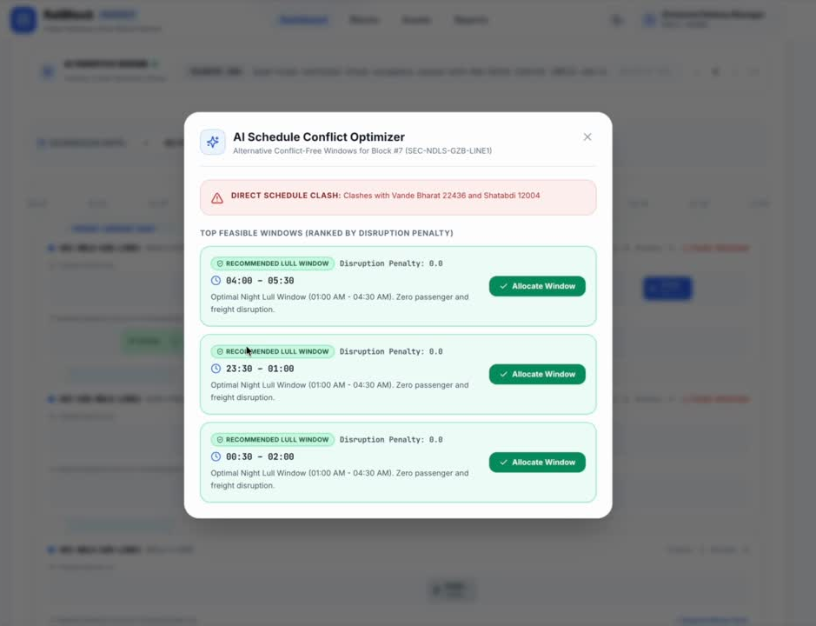
RESEARCH, BENCHMARKS & REFERENCES
LastCommit
Indian Railways Institutional Groundwork
• CAG Railway Audit (Report No. 22): Empirical data connects uncoordinated maintenance & asset failures to 22.20% of total railway punctuality loss.
LINK: (CAG Report No. 22 of 2021↗️)
• CAMTECH Guidelines: Standard Operating Procedures for Traffic & Power Blocks, 25kV OHE isolation, work permits, and machine/staff log registers
LINK: (CAMTECH Handbook↗️).
• IRICEN Rolling Block Research: Studies on rolling block programs, corridor-based maintenance coordination, and AI block-window identification methodologies
LINK:(IRICEN Rolling Block Research↗️.).
• IndiaAI (Ministry of Railways): Documented AI use-cases in track condition assessment, acoustic bearing monitoring, and predictive signalling maintenance frameworks.
LINK: ( IndianAI-Ministry of Railway↗️.)
• TCS Railway Asset Management Research: AI/ML frameworks demonstrating quantifiable line-capacity benefits of bundling multi-department maintenance into consolidated access windows.
LINK: (TCS Research↗️)
• Indian Railways G&SR Standards: General & Subsidiary Rules governing absolute/automatic block working, safe braking headways, and Control Office Application (COA) protocols.
LINK: (Indian Railways G&SR-2025↗️.)
• JR East (Japan): AI-based proactive condition monitoring, smart track inspection cars, and condition-based predictive maintenance protocols.
LINK: (.JR East↗️)
• Deutsche Bahn (Germany): AI-driven train dispatching and automated timetable optimization engines for ultra-dense mixed passenger/freight rail networks.
LINK: (Deutsche Bahn↗️.)
• European Rail Joint Scheduling: Scientific research models for simultaneous mathematical optimization of train paths and scheduled infrastructure track possession.
LINK:( Research Paper↗️.)
Industry Research & AI Initiatives
Global Railway Benchmarks
BRIDGING THE MISSING IN INDIAN RAILWAYS
• Existing RBPMS/workflows + AI optimization → intelligent coordinated block planning.
• Our Breakthrough: An end-to-end algorithmic decision layer that transforms siloed maintenance requests into conflict-free, multi-department Mega-Blocks, strictly enforcing safety buffers and optimizing asset uptime.
• Empirical Reproducibility: Tested on authentic Northern Railway operational simulations with verified mathematical before-vs-after metrics.
LINK: RBPMS↗️..
@SIH Idea submission- Template
6

